Slide 1
Leadership & Gender-Based Violence:
Conversation, Information and Support
Notes:
Confirm title

Slide 2
Objectives
Encourage Conversation regarding your personal leadership journey and about addressing Gender-Based Violence in the Philippines
Provide Information about how to enhance your capacity as a leader and how to recognize and respond – safely and with consent – to the needs of survivors of violence
Improve Support for you as a leader at Avon and in your community, and enable you to pay forward your opportunities and learnings to your friends, families, and communities

Slide 3
Support Is Available
Gender-Based Violence (GBV) is a complex, difficult topic
Support is available throughout the day
Please take care of yourself and take breaks as needed
Feel empowered to access a quiet space any time you need it
We will discuss to the concept of self-care later in the day

Slide 4




Voices Against Violence:
The GBV Global Initiative
Main Objective
To ensure victims and survivors of gender-based violence and harmful practices around the world have better access to the services, protection and justice they deserve.
Funded by the U.S. Department of State and the Avon Foundation for Women

Slide 5
Avon Spotlight
Fighting for women for over
60
years
In over
50
markets worldwide
More than
$1 billion USD
donated for safer, better lives

Slide 6


Slide 7
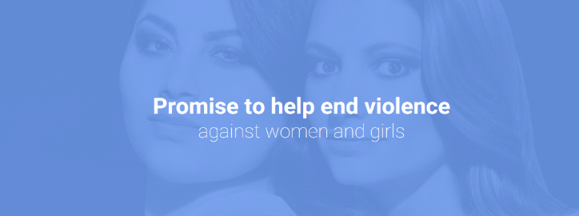
The Avon Promise
We believe in a world where women and girls can live a life free from violence and abuse.

Slide 8
One in three women will be a victim of violence in her lifetime. We see every women as a person – not as a statistic – and each instance of violence is one too many. The paths that lead to these crimes often start at home and within relationships that should be sanctuaries of trust and love.
That is why we’re renewing our commitment to help end violence and abuse within relationships – whether it’s physical, emotional, or financial.
We’ll commit our resources, our people, and our energy to:

Slide 9
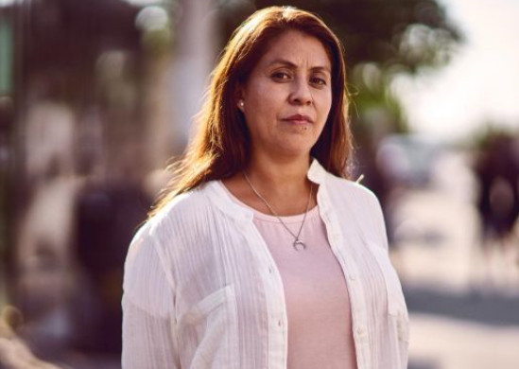
Encourage conversation
We’ll use our global voice to shed light on the many forms of violence against women and girls and discuss what needs to change in order to end it.

Slide 10



Provide information
We’ll make sure that everyone we work with – our network of Representatives, employees, customers and partners – has the knowledge and information they need to recognise and respond to violence safely and on their own terms.

Slide 11

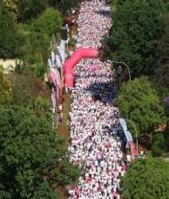
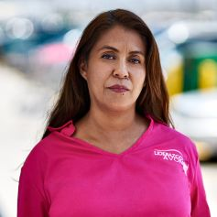
Improve support
We’ll work with local organizations to ensure women and girls have access to the support they need. We’ll convene global leaders and change makers to help make sure women and girls are understood, supported, and treated fairly when they seek help or report abuse.

Slide 12
Module 1: Leadership
Notes:
Link to Jenn’s Prezi

Slide 13
Vital Voices’ Leadership Model

Slide 14
Module 2: Self-Care

Slide 15
Learning Objectives
Recognize compassion fatigue, and the differences between burnout and secondary trauma, in yourselves and others
Identify wellness strategies that can be used, on an individual and organization level, to improve or eliminate harmful effects of compassion fatigue
Hold yourself accountable to practicing self-care during this workshop and beyond

Slide 16
“
As we listen empathically to the stories of our clients, it becomes impossible not to enter their world and experience their pain.
– Shallcross, 2013
”

Slide 17
Professional Quality of Life
Compassion Satisfaction
Compassion Fatigue
Beth Hudnall Stamm, 2009. Professional Quality of Life Scale (ProQOL). http://www.proqol.org

Slide 18
Compassion Satisfaction
Positive feelings from doing your job well
Positive relationships with colleagues
Feeling your work makes a difference

Slide 19
Compassion Fatigue
Compassion Fatigue (compassion stress, secondary traumatic stress) is common in the care giving field
Practitioners working with victims/survivors can experience pain as a result of their exposure to others’ traumatic experiences
They may experience physical, psychological, emotional, spiritual, and professional manifestations of this fatigue

Slide 20
Burnout and Secondary Trauma
The negative aspects of helping
The negative aspects of working in helping systems may be related to:
  Providing care
  The system
  Work with colleagues
  Beliefs about self
Compassion Fatigue
Secondary Trauma
Burnout
Deth Hudnall Stamm, 2009. Professional Quality of Life Scale (ProQOL). http://www.proqol.org.

Slide 21
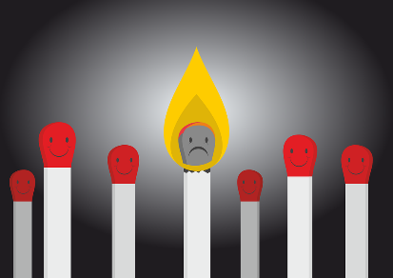
What is Burnout?
Results from the work environment/conditions, e.g. workload, rather than exposure to another person’s
trauma
  Reaction to chronic occupational
  stress
  Occurs over time
  Does not only occur if you do not
  like your job!

Slide 22
Symptoms of Burnout
Physical and Emotional Exhaustion
  Forgetfulness and/or impaired concentration and attention
  Physical symptoms may include chest pain, heart palpitations, shortness of breath, digestive pain, dizziness, fainting, and/or headaches
  Chronic fatigue
  Insomnia
  Increased illness
  Loss of appetite
  Anxiety
  Depression
  Anger

Slide 23
Symptoms of Burnout, cont’d
Cynicism and Detachment
  Loss of enjoyment
  Pessimism
  Isolation
  Detachment
Feelings of ineffectiveness and lack of accomplishment
  Feelings of apathy and hopelessness
  Increased irritability
  Lack of productivity and poor performance

Slide 24
What is Secondary Trauma?
Secondary trauma, or “vicarious trauma”, results from working with someone who has experienced trauma
  Trauma: A deeply distressing or disturbing experience that often exceeds our capacity to cope
  The client’s trauma becomes a trauma event for the provider
  Service provider begins to experience trauma symptoms and cognitive changes in themselves

Slide 25
Symptoms of Secondary Trauma
Under-controlled
Over-controlled
Excessive blaming
Voices excessive complaints about administrative functions
Substance abuse
Overspending, overeating, gambling, sexual addictions
Legal problems
Bottled-up emotions
Isolation from others
Excessive complaints from others
Poor self-care
Mentally and physically tired

Slide 26
Symptoms of Secondary Trauma, cont’d
Under-controlled
Over-controlled
Aggression
Exaggerated responses
Anxiety and panic attacks
Depression
Detachment (making jokes about the work or the clients)
Detachment from things you previously cared about
Preoccupied
Denial
Apathy
Depression
Feeling lethargic
Cynical

Slide 27
Organizational Impact
In a public statement in May 2019, the WHO made it clear that burnout is not a medical condition in and of itself—but rather an “occupational phenomenon” affecting health
From a socio-economic viewpoint, burnout is the source of 50% of the sick leaves in the European Union and annually affects up to 40 million workers, which costs more than 20 million euros
Studies carried out in the United States have also shown high costs due to work absenteeism caused by stress-related conditions and costs due to diseases
Studies also show that burnout leads to turnover, which can harm productivity, resulting in negative impacts on organizational efficacy
https://www.frontiersin.org/articles/10.3389/fpsyg.2018.00662/full
https://www.who.int/mental_health/evidence/burn-out/en/

Slide 28
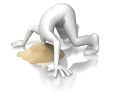
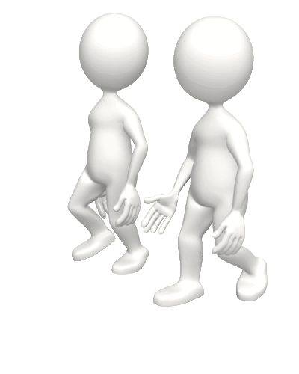


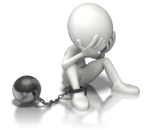


Risk and Resiliency Factors
Personality and Coping Style
Spiritual or other Resources
Social Support
Current Life Circumstances
Work Style
Past Trauma History

Slide 29

Dimensions of Wellness
Physical wellness
Intellectual wellness
Emotional wellness
Spiritual wellness
Relationship/Social wellness
Professional/Occupational wellness

Slide 30
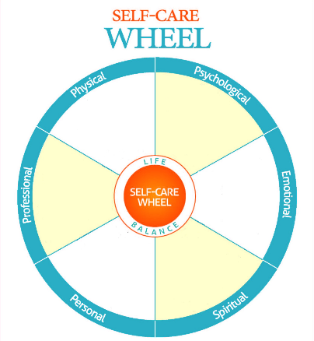
Self-Care Wheel Activity
The wheel breaks self-care down into six dimensions of wellness
Examine the wheel:
  Which parts are you strong in?
  Which parts could use more of your attention?
  Fill in the wheel with your own activities and tools for self-care

Slide 31

Self-Care “Homework”
Create and connect with your community
Utilize self-assessment tools
Build a self-care practice
Pursue organizational change
You can’t pour from an empty cup. Take care of yourself first.

Slide 32
Create and Connect with Community
Consider connecting with your network of peers to process and exchange about challenges and successes in your work life
Consult with expert colleagues about safe ways to practice self-care and manage compassion fatigue
Maintain a network outside of the work that you are doing that may provide you with a safe place to process and reflect

Slide 33
Self-Assessment Tools
Professional Quality of Life Scale (ProQOL) is a free tool for self-reflection and resiliency planning
A 30 item self-report measure of the positive and negative aspects of caring
Helps measure Compassion Satisfaction and Compassion Fatigue
Beth Hudnall Stamm, 2009. http://www.ProQOL.org

Slide 34
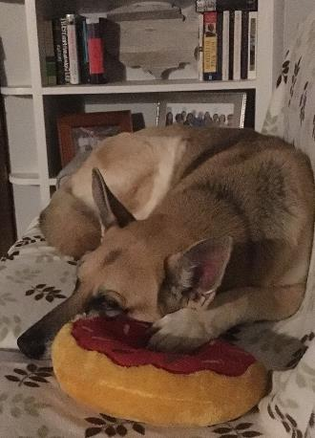
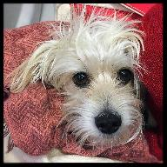
Self-Care Practice
Two minutes
  Breathe
  Stretch
  Daydream
  Laugh
  Doodle
  Acknowledge one of your accomplishments
  Say no to a new responsibility
  Compliment yourself
  Look out the window
  Spend time with your pet
  Share a favorite joke
Notes:
ADD PICS!

Slide 35

Self-Care Practice, cont’d
Five minutes
  Listen to music
  Have a cleansing cry
  Chat with a co-worker
  Sing out loud
  Jot down dreams
  Step outside for fresh air
  Enjoy a snack or make a cup of coffee/tea

Slide 36
Self-Care Practice, cont’d
Ten minutes
  Evaluate your day
  Write in a journal
  Go for a walk
  Call a friend
  Meditate
  Tidy your work area
  Assess your self-care
  Draw a picture
  Dance
  Listen to soothing sounds
  Surf the web
  Read a magazine

Slide 37


Self-Care Practice, cont’d
30 minutes
  Exercise
  Eat lunch with a co-worker
  Take a bath
  Read non-work related literature
  Spend time in nature
  Practice yoga
  Watch your favorite television show

Slide 38

Self-Care Practice, cont’d
Taste:
Green tea
Chocolate
Mango
Gum
Crunchy snack
Vegetable soup
Milk
Oatmeal
Celery
Bananas
Nuts and seeds
Eggs
Smell:
Lavender
Eucalyptus
Peppermint
Green apple
Coconut
Sounds:
Leaves
Water stream
Seaside
Water
Fireplace
Rain
Wind
Forest
Fan
White noise

Slide 39
Self-Care Practice, cont’d
Touch:
  Playdough/putty
  Soft objects
  Stress-relief magnets
  Stress balls
  Tactile beads
  Wood, metal, etc.
  Rubber bands
  Rubbing stones
  Beanbags
  Kneading eraser
Sight:
  Use your favorite color
  Wallet-sized picture of someone or something you enjoy
  Landscapes
  Baby animals
  Funny photos
  Pictures
  Blowing bubbles
  Positive affirmations

Slide 40
Approaches to Mitigate/
Prevent Exposure
Individuals and organizations have a responsibility to take steps to prevent burnout and to develop supports for coping with exposure to trauma
Strategies are most effective when they are complementary
Individual strategies alone are often insufficient…

Slide 41
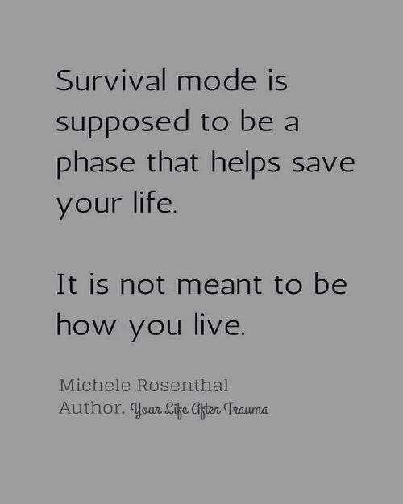
Organizational Change
Support workplace self-care groups
Enhance the physical safety of staff
Offer flextime scheduling
Incorporate secondary trauma training

Slide 42
Organizational Change, cont’d
Provide adequate clinical supervision, including reflective supervision
Maintain trauma caseload balance
Create external partnerships with secondary trauma intervention providers
Train organizational leaders and non-clinical staff on secondary trauma

Slide 43

Organizational Change, cont’d
Provide ongoing assessment of staff risk and resiliency
Include trauma/burnout in orientation and onboarding
De-stigmatize secondary trauma
Provide staff in-service learning about trauma, stress, management, self-care, resources
Make available to confidential consultation with no repercussions
Source: National Child Traumatic Stress Network

Slide 44
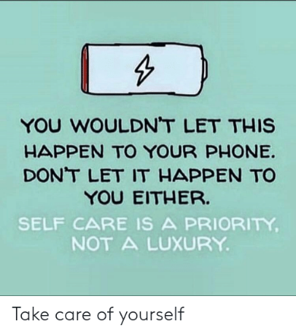
Organizational Change, cont’d
Conduct regular check-ins with staff on workload, overtime
Provide quiet space for calming, regulating nervous system
Debrief with staff after crises
Include staff care in budgets

Slide 45
Module 3: Gender-Based Violence

Slide 46
Agenda
Gender-Based Violence (GBV): Global & Local Context
Definitions
Dynamics of GBV
Practical Applications
Moving Forward

Slide 47
Global & Local Context

Slide 48
Around the world, women are a minority
Not in amount, but in:
Access to Rights
Vulnerability in the face of constant discrimination in a patriarchal society

Slide 49
Global Gender Gaps
Males hold 78% of executive positions.
Women receive 26.2% less tan men for the same job.
Women are 27 times more likely to suffer from digital abuse.
Women devote 6.4 hours a day to domestic, non-renumerated tasks as opposed to men (3.4 hours per day).
UN Women; UNDP

Slide 50
Gender Inequality Across the Globe
According to UNDP, though women comprise more than 50% of the world's population, they only own 1% of the world's wealth
According to the UN, in 18 countries, husbands can legally prevent their wives from working; in 39 countries, daughters and sons do not have equal inheritance rights; and 49 countries lack laws protecting women from domestic violence

Slide 51
Gender Inequality & Violence
It is not gender roles that cause inequality, but the value placed on those roles that do
Gender norms result in power of men over women leaving many women vulnerable and powerless in the face of violence against them

Slide 52
GBV & VAW
Globally, 1 in 3 women, and 1 in 4 men, experience violence in their lifetimes
According to UN Women, GBV is a major cause of disability and death for women aged 15–44 years
It is estimated that of the 87,000 women who were intentionally killed in 2017 globally, 58% were killed by intimate partners or family members, meaning that 137 women across the world are killed by a member of their own family every day
More than a third (30,000) of the women intentionally killed in 2017 were killed by their current or former intimate partner

Slide 53
GBV in the Philippines
1 in 5 aged 15-49 experienced violence at least once in lifetime
1 in 4 (26%) ever-married women aged 15-49 have experienced physical, sexual, or emotional violence by their husband or partner
1 in 10 aged 15-19 is already a mother or pregnant with first child
Gender Inequality Index Rank - 96
Global Gender Gap Index Rank - 7
.
Sources: 1. Report by the Philippine Commission on Women titled “The State of Filipino Women” dated May 24, 2018; 2. 2017 National Demographic and Health Survey by Philippine Statistics Authority; 3. Gender Inequality Index: United Nations Development Programme, Human Development Report 2016; 4. Gender Gap Index: World Economic Forum, the Global Gender Gap Report 2016.

Slide 54
PowerPoint Infographics Sampler
STATISTICS
Women Safety Modules under 2008 and 2013 National Demographic and Health Surveys conducted by Philippines Statistics Authority
“Violence Against Women.” Philippines Commission on Women. May 2014. https://pcw.gov.ph/statistics/201405/statistics-violence-against-filipino-women
Percentage distribution of women's help seeking behavior: 2013
Notes:
Source: Philippine Commission on Women official website: https://pcw.gov.ph/statistics/201405/statistics-violence-against-filipino-women

Slide 55
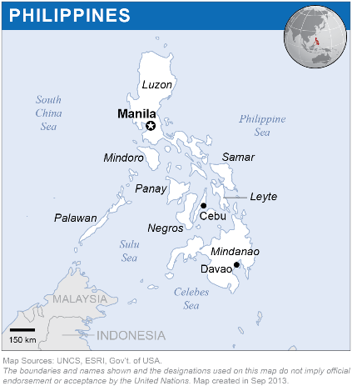
UN Women: GBV in the Philippines
Global Database on Violence against Women
17%
Lifetime Physical and/or Sexual Intimate Partner Violence
7%
Physical and/or Sexual Intimate Partner Violence in the last 12 months
15%
Child Marriage

Slide 56
Small Group Discussion/Large Group Report Back
Discuss ways VAW/GBV could or has come into play in your role(s) at Avon
Caveat: Disclosures

Slide 57
Role play: Vanessa & Charice
At your tables:
Table Faculty plays role of Vanessa
2 people play role of interviewers
2 people play role of observers, who will watch the interview and then give the interviewer(s) feedback about what they observed during the interview
Notes:
Instructions: (distribute Practice handouts)

Slide 58
Definitions

Slide 59
What is Gender?

Slide 60
Sex vs. Gender
Sex refers to the biological and physiological characteristics of males and females (e.g. reproductive organs, chromosomes, hormones)
Gender refers to the norms, roles, relationships, activities, responsibilities, and attitudes of women and men. It varies from society to society and it can be changed
Engender Health

Slide 61
Gender
Gender roles, relationships and responsibilities result in different opportunities and limitations for women and men
Roles are hierarchical and privilege one gender over another, leading to unequal power relations

Slide 62
Social Construct of Gender
Gender describes different expectations, roles, beliefs and behaviors “assigned” to men and women – sometimes knows as “masculinity” or “femininity”
Gender, or masculinity and femininity, based on social, religious, cultural and historical norms about what is deemed appropriate for men/boys and women/girls
There are no “right” or “wrong” gender norms, but they can contribute to mistreatment of one sex over another and differences in power and opportunism

Slide 63
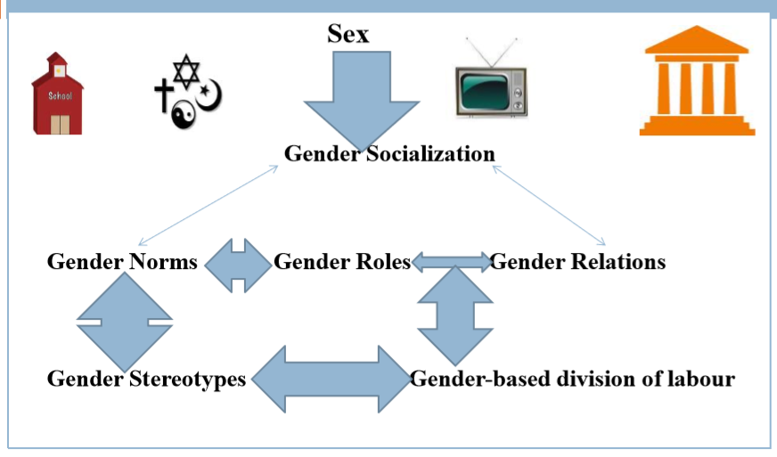
https://core.ac.uk/download/pdf/77101394.pdf

Slide 64
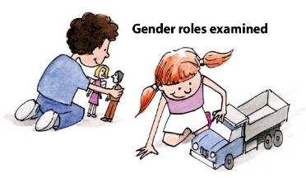
Power & Social Norms
Gender Socialization: From an early age, this process is done differently for boys than for girls, enhancing behaviors and attitudes in each sex based on what society considers as the feminine and masculine, i.e. , to its gender role
By the age of 6, most kids think boys are better at math and programming skills.
https://science.sciencemag.org/content/355/6323/389

Slide 65

Stereotypes
Set of fixed and naturalized ideas regarding the behaviors considered as ideals and proper of men and women
From an early age, this process is done differently for boys than for girls, enhancing behaviors and attitudes in each sex based on what society considers as the feminine and masculine, i.e. , to its gender role

Slide 66
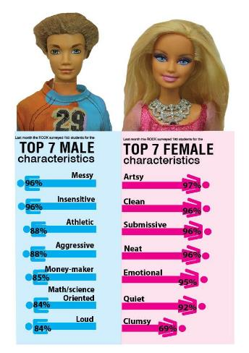

Stereotypes
Aim to define and normalize their behaviors, thoughts, feelings and image in relation to the appropriate and ideal of the feminine and the masculine

Slide 67


Example: Media
Example upholding gender norms and power structures through the sexualization of a woman’s body and normalizing predatory behavior of men

Slide 68
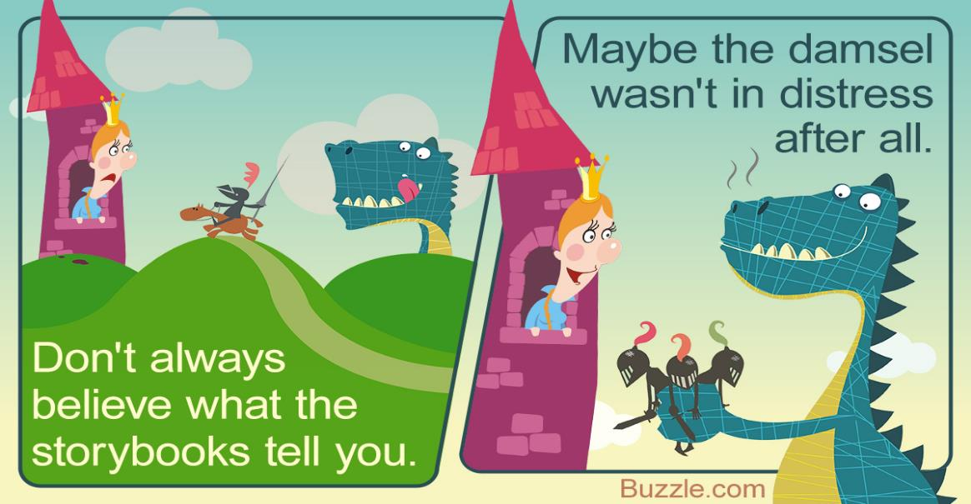

Slide 69
What is Feminism?

Slide 70

Feminism Group Poll
4. The pursuit of women’s supremacy over men
1. The opposite of machismo
2. It recognizes that there is gender inequality between woman and men and that this is unfair
5. Social political movement that seeks equal rights between men and women
3. Small group of women struggling to take men's rights
6. A group of women that believe all men are violent

Slide 71
What is Power?
What is Violence?

Slide 72

Power
Power is the ability to control and access resources, opportunities, privileges, and decision-making processes
It can be real or perceived
Physical, economic, political, social, educational, gender-based, age-based, class-based, ethnicity, religion, etc.

Slide 73

Power & Violence
Results in violence against those without power that infringes upon their rights as humans
  Harmful physical, sexual, emotional, psychological, social, economic abuses or the denial of resources and opportunities

Slide 74
What is Gender-Based Violence?

Slide 75
GBV & VAW
For purposes of our discussions, gender-based violence (GBV) refers to any act of violence that results from power inequalities based on socially prescribed gender roles, expectations, and norms
This may include acts of violence or threats that result in physical or psychological harm or suffering for someone of any gender
  Disproportionately (but not exclusively) affects women and girls because of their socially subordinate status in relation to men and boys increases vulnerability

Slide 76
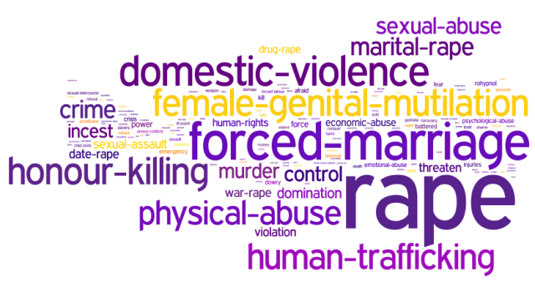
GBV Continuum
When discussing GBV we should consider the full continuum of violence, including: domestic violence/intimate partner violence, sexual violence, sex trafficking, female genital mutilation/cutting, forced marriage, other harmful traditional practices, etc.
Occur at different stages in life: prenatal phase, childhood and adolescence, reproductive years, seniority

Slide 77
GBV & VAW
“Violence against women” is often used interchangeably with GBV
The UN defines VAW as "….any act of gender-based violence that results in, or is likely to result in: Physical, Sexual, Psychological harm or suffering to men or women, including threats of such acts, coercion or arbitrary deprivations of liberty, whether occurring in public or private life.”

Slide 78
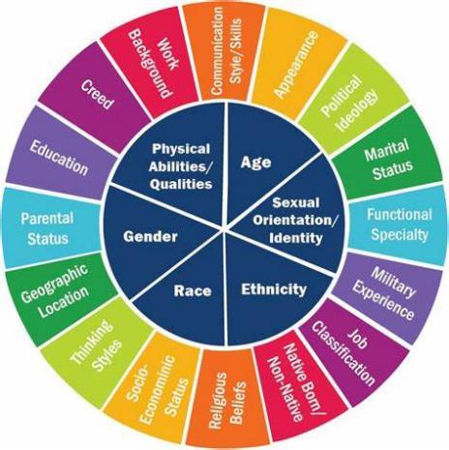
Intersectionality
Violence Doesn’t Discriminate: As with all forms of abuse, financial abuse occurs across socio-economic, educational, racial and ethnic groups
…Or does it? However, it is important to acknowledge the systems of privilege and oppression that exacerbate this, and all forms of abuse.
  Certain communities experience violence at much higher rates. Power dynamics reinforce this.

Slide 79
Dynamics of Gender-Based Violence

Slide 80
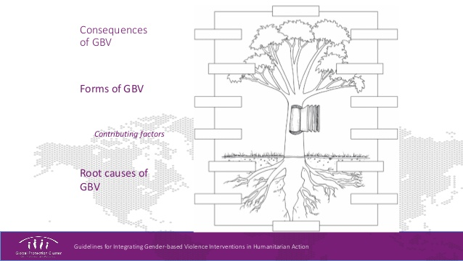
GBV: Root to Leaves

Slide 81
Root Causes (& Contributing Factors)
Power imbalance (Behavioral: alcohol, drugs, retaliation, etc.)
Gender inequalities (Structural)
Disregard for human rights (Systems- impunity, representation, participation, etc.)

Slide 82
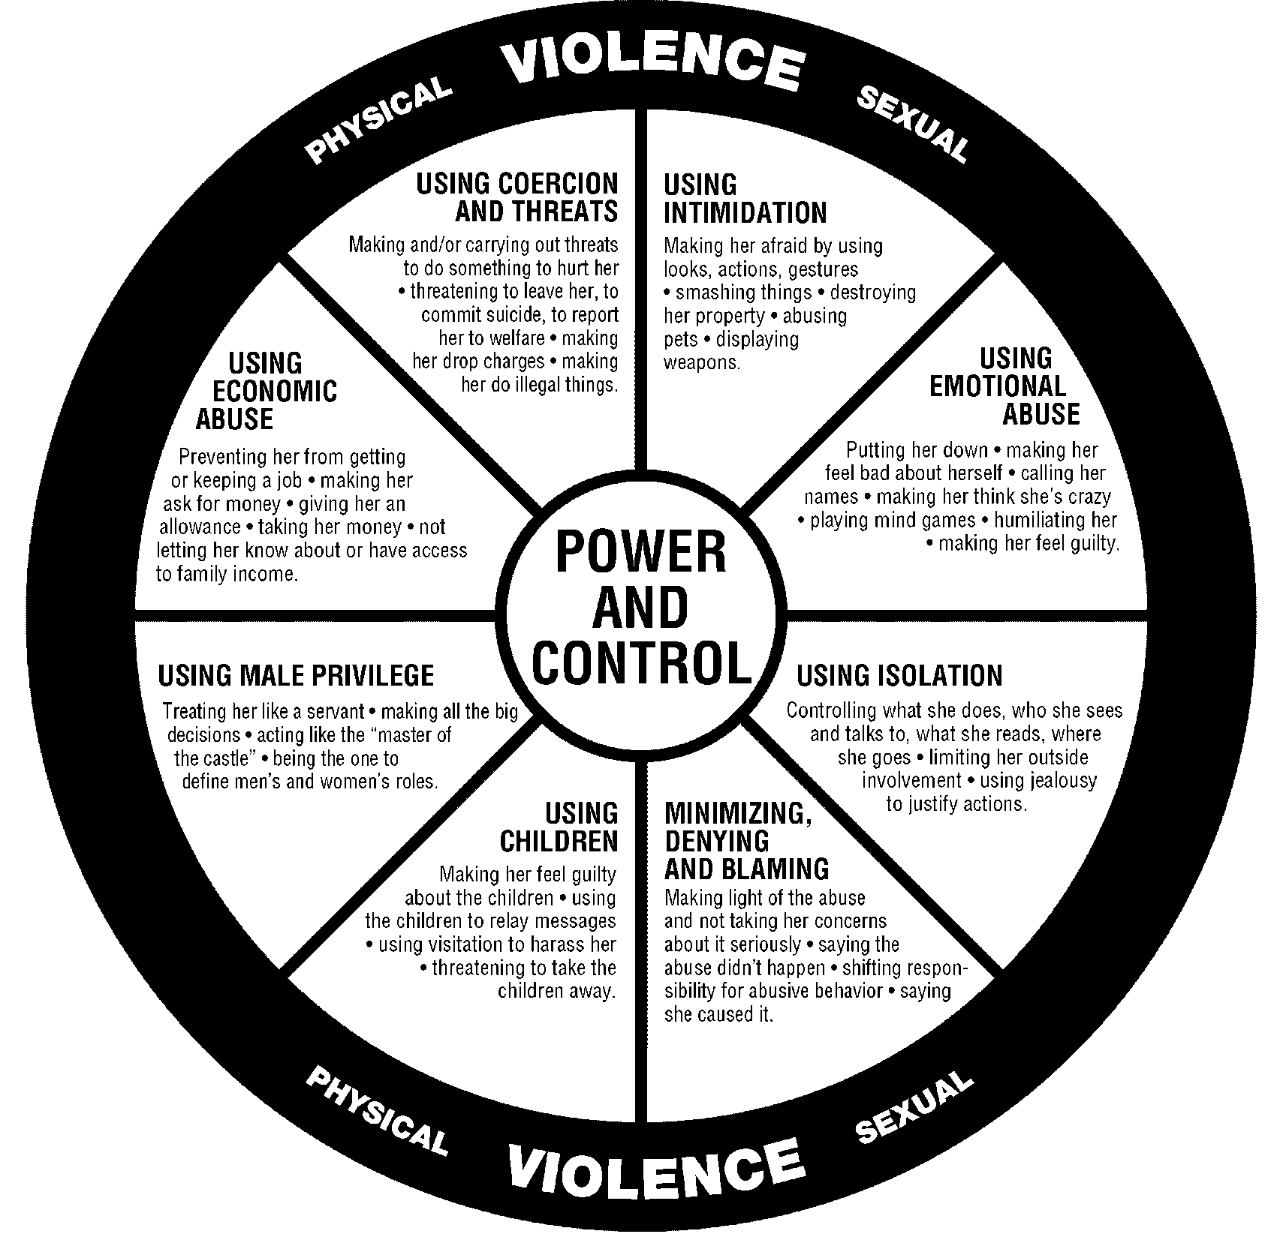
Forms of Violence
Domestic Abuse Intervention Project, Duluth, Minnesota

Slide 83

Large Group Discussion: Recognizing Signs

Slide 84


He puts her down in private and in public

Slide 85
He puts her down in private and in public
He controls the phone and her social networks

Slide 86
He puts her down in private and in public
He controls the phone and her social networks
She gets nervous when she sees him coming

Slide 87
He puts her down in private and in public
He controls the phone and her social networks
She gets nervous when she sees him coming
She stops working because he doesn’t want her to

Slide 88

He puts her down in private and in public
He controls the phone and her social networks
Feelings of inadequacy
She gets nervous when she sees him coming
She stops working because he doesn’t want her to

Slide 89

He puts her down in private and in public
He controls the phone and her social networks
He tries to dictate her finances.
Feelings of inadequacy
She gets nervous when she sees him coming
She stops working because he doesn’t want her to

Slide 90

He puts her down in private and in public
He controls the phone and her social networks
He tries to dictate her finances.
Feelings of inadequacy
Anxiety
She gets nervous when she sees him coming
She stops working because he doesn’t want her to

Slide 91

Stigma
He puts her down in private and in public
He controls the phone and her social networks
He tries to dictate her finances.
Feelings of inadequacy
Anxiety
She gets nervous when she sees him coming
She stops working because he doesn’t want her to

Slide 92

Stigma
He puts her down in private and in public
Forced Sex
He controls the phone and her social networks
He tries to dictate her finances.
Feelings of inadequacy
Anxiety
She gets nervous when she sees him coming
She stops working because he doesn’t want her to
Depression

Slide 93

Feelings of discomfort, fear, and pressure with criminal justice process
Stigma
He puts her down in private and in public
Forced Sex
He controls the phone and her social networks
He tries to dictate her finances.
Feelings of inadequacy
Anxiety
She gets nervous when she sees him coming
She stops working because he doesn’t want her to
Depression

Slide 94

Feelings of discomfort, fear, and pressure with criminal justice process
Stigma
He puts her down in private and in public
Forced Sex
He controls the phone and her social networks
She is isolated from her friends and family
He tries to dictate her finances.
Feelings of inadequacy
Anxiety
She gets nervous when she sees him coming
She stops working because he doesn’t want her to
Depression

Slide 95
Why does she/he/they:
Stay?
Not disclose?
Not report?

Slide 96
Large Group: Why do women not: speak up, report, leave
Non-perception of abuse
Concern for children
Shame and guilt
Conflicts between duty to be and wanting to be
The hope that it changes
The aggressor's emotional dependence
The feeling of failure
Insecurity and low self-esteem
Social mandate
Fear of an uncertain future and society
Social isolation
Fear of the aggressor's retaliation
Fear of lack of economic resources
Fear or lack of understanding about criminal justice process
These and other forms of INTIMIDATION

Slide 97
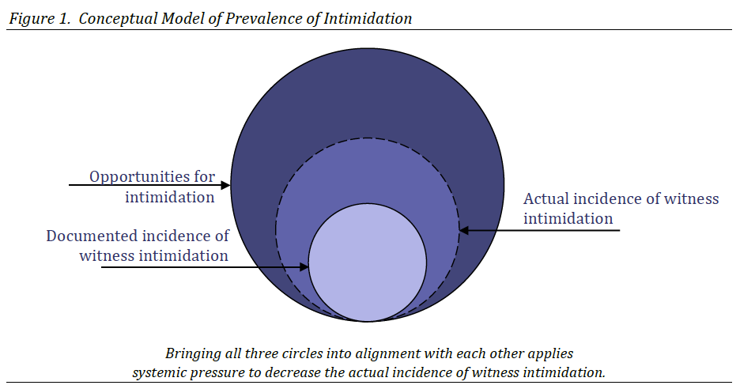
Intimidation
Before, during, and after
Franklin Cruz & Teresa M. Garvey, Justice Management Institute, AEquitas: The Prosecutors’ Resource on Violence Against Women, Improving Witness Safety and Preventing Witness Intimidation in the Justice System: Benchmarks for Progress (2013).

Slide 98
Impact of Intimidation
Continuing fear of abuser
Reluctance to disclose details of abuse
Isolation from friends, family, community
Unwillingness to participate in prosecution
Frequent recantation

Slide 99
Common Hallmarks of Intimidation
Threats against the victim or others – implied or direct
Verbal abuse
Psychological manipulation
Physical abuse
Sexual abuse
Stalking
Financial control
Making arbitrary rules and demanding compliance
Threats of abuse of the legal system

Slide 100
Hallmarks of Intimidation, cont’d
Victim blaming
Exploiting traditional gender roles
Isolating the victim from family and friends
Humiliation in front of others

Slide 101
Modern Hallmarks of Intimidation
Technology as method of intimidation
  Location tracking and other tracking apps
Social media as method of intimidation
  Facebook, Snapchat, chat apps, etc.
Note: Social media’s role in normalizing violence against women
  E.g., #GolpearMujuresEsFelicidad
A Women’s Aid survey found that 41% of respondents’ partners or ex-partners used their online activities to track them.

Slide 102

Myths & Myth Busting
Shared Social Beliefs
Not necessarily valid or true
Reproduced unconsciously in everyday life
Sometimes guide action

Slide 103
He hits his partner because sometimes he cannot control himself…
It only occurs in poor families where there is no education…
She probably did something to provoke him…
Be careful, there are also battering women…
I don’t get involved; it’s the couple’s issue… it’s private…
Women like it rough; If they didn’t, they would leave…
Men who beat their wives are sick or crazy…

Slide 104
Coming Forward is Difficult
Compare lack of motive to lie with embarrassment of coming forward, medical examination, testifying, police interviews, etc.
Myth: “She is only saying she didn’t want it now because she regrets doing it”

Slide 105

Consent
Consent means saying “yes,” agreeing to something
Informed consent means making an informed choice, freely and voluntarily by persons in equal power relationships
  Acts of GBV occur without informed consent
  Saying yes is not true consent if under duress
  Children under a certain age are unable to give informed consent for acts such as sexual relations, marriage, or FGM/C

Slide 106
Inconsistent Accounts are Normal
Neurobiology of trauma may cause inconsistencies in statements
Survivor may be embarrassed about behavior
Survivor may fear getting in trouble for certain behavior
Myth: “If she were telling the truth, it would be the same every time”

Slide 107
Medical Evidence of Sexual Assault Frequently Does Not Exist
In the overwhelming majority of cases, victims do not have injuries after a sexual assault
When they do have injuries, doctors can still not say whether they are the result of consensual or non-consensual sexual activity, though they can sometimes say whether or not it is consistent with what the victim reports
Myth: “If she didn’t want it, she would have had injuries”

Slide 108
Perpetrator is Usually Known to the Victim
This dynamic can make it hard for victims to react, because the offender is often someone they trusted
Victims frequently wonder if it’s their fault or if they invited the assault somehow
Myth: “Women need to fear the stranger hiding in the bushes”

Slide 109

Victim-Blaming
Global studies show that only around 7 percent of survivors of GBV formally reported the violence to police, medical, or social services, etc.
One of the reported reasons for this is centered on shame, which is further exacerbated by victim blaming
Victim blaming occurs when the victim of a crime or any wrongful act is held entirely or partially at fault for the harm

Slide 110
GBV Summary
Violence based on gender relations, roles, norms, expectations, limitations, etc.
Violates universal human rights as well as national/local laws
Involves an abuse of power
Involves some type of force (including threat or coercion)
Results in harm
Characterized by lack of consent
Survivors face unique barriers to justice and support

Slide 111
Consequences
On global, regional, national, community and individual scale
  GBV is a cause and consequence of women’s inferior political, economic and social status
Individual
  Physical (injury, disease, death)
  Psychological (fear, anxiety, depression)
  Social (stigmatization, isolation, etc.)
  Economic (decreased earning, increased poverty, etc.)

Slide 112
Practical Applications

Slide 113
What Can I do?

Slide 114
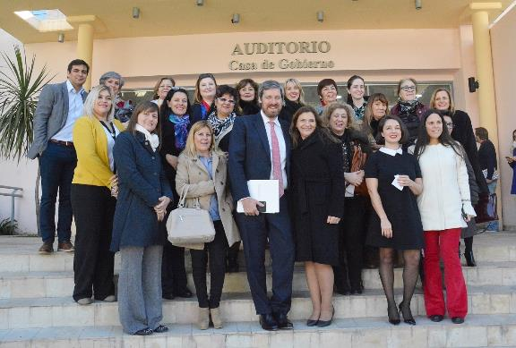
As an Individual
Primera Escucha (Avon Argentina) means “To accompany woman survivors of violence in their first steps”
  Recognize Signs
  De-bunk Myths
  Offer Support

Slide 115
Victims/Survivors
Strengthen
Support
Corroborate
Prepare
Heal

Slide 116
Responding to Disclosures by Supporting Survivors
Recognize that there are many reasons that victims do not cooperate
Treat all victims– with respect
Use nonjudgmental and supportive dialogue
Link the victim to resources that enhance her/his safety
Work with advocates to foster better victim communication as well as connect them to resources

Slide 117
What Should I Know?

Slide 118
Coming Forward is Difficult
In most cases, it is not easy for a survivor to disclose an assault or assaults that took place behind closed doors (or anywhere!)
This is often something that happens after some degree of internal struggle, and at some personal cost
False accusations are rare and happen at about the same rate for sexual assault as they do for any other crime

Slide 119
Perpetrator is Usually
Known to the Victim
Survivors are much more at risk of being assaulted by a friend, family member, acquaintance or other person that they know than by a stranger
Around the world, about 80% of sexual assaults are committed by someone known to the victim

Slide 120
Understanding Victim/Survivor Behaviors
Understanding behavioral patterns is key to getting the victim/survivor the help that she/he needs
Recognizing signs of trauma makes you better able to explain the victim’s non-intuitive or unexpected reactions to others
A supported survivor is better able to participate in the investigation and prosecution of the case

Slide 121
Victim/Survivor Behavior is Not Always Intuitive
Lack of emotion – flat/no affect
Contextually inappropriate laughter/giggling
Delayed disclosure or total failure to report
Promiscuity
Increase in delinquency/criminal behavior
Continued contact with the offender

Slide 122
Trauma Amplifiers
Betrayal by someone trusted
Constant fear of assaults and anxiety by abuser's constant presence
Shame
Blame by abuser or others
Lack of support, especially in response to an initial disclosure

Slide 123
Medical Consequences of Trauma
Post-Traumatic Stress Disorder (PTSD)
Drug and alcohol abuse
Depression
Anxiety
Suicidal tendencies
Various psychological markers
  Dysfunctional family relationships
  Psychosexual issues
  Eating disorders
  Personality changes/mood swings

Slide 124
Post-Traumatic Stress Disorder
Mental health condition which is triggered by a traumatic event
Symptoms can include:
  Flashbacks (reliving the trauma)
  Nightmares
  Severe anxiety
  Uncontrollable thoughts about the event
  Avoidance of talking about the event or anything that reminds victim of it
  Source: http://www.mayoclinic.org/diseases-conditions/post- traumatic-stress-disorder/basics/definition/con-20022540

Slide 125
Post-Traumatic Stress Disorder, cont’d
Can lead to:
  Negative changes in victim’s thinking and mood
  Negative feelings about themselves and inability to experience positive emotions
  Feeling emotionally numb
  Lack of interest in activities previously enjoyed
  Hopelessness about the future
  Memory problems, including not remembering important aspects of the traumatic event
  Difficulty maintaining close relationships

Slide 126
Post-Traumatic Stress Disorder, cont’d
Can lead to:
  Changes in emotional reactions
  Irritability, angry outbursts or aggressive behavior
  Always being on guard for danger
  Overwhelming guilt or shame
  Self-destructive behavior
  Trouble concentrating
  Difficulty sleeping
  Being easily startled or frightened
  Hyper vigilance

Slide 127
Additional Potential Medical Consequences of Sexual Assault
Exposure to sexually transmitted infections (STIs)
Pregnancy
Gynecological, psychological, gastrointestinal, and sleep disorders
Pain syndromes
Co-occurring physical & emotional abuse can lead to more complex trauma
Poor growth/development
Increased drug/alcohol use
Juvenile delinquency/adult criminality
Interrelated crimes – human trafficking
Death

Slide 128
What Should I Say?
How Should I Say it?

Slide 129
Quick Reference Counseling Guide
R elationship with the caller
I dentify the need
D eal with feelings
E xplore alternatives (including referrals).
S afety

Slide 130
Relationship with the Client
Establish/Maintain a Relationship
Listen:
  Don’t Interrupt
  Don’t Give Advice
I’m glad you told me. I’ll help you in any way I can.
I’m sorry this happened to you. You called the right place.

Slide 131
Identify the Problem/Need
Paraphrase what you hear the problem to be so you are on the same page
Ask these questions if you need further help clarifying:
  What happened today that made you want to share this?
  You’re going through so much. What would you say is your biggest concern right now?
  Your daughter’s boyfriend is abusing her. She wants to end it, but he won’t let her go. You’re afraid he will really hurt her.

Slide 132
Deal with Feelings
Dealing with feelings (through empathy) helps a person feel understood and recognizes that they are going through something.
Use these empathetic response leads to reflect feelings.
  You sound…
  I hear you saying that you…
  So it makes you feel…
  The thing you feel most right now is…
  You feel…
  It sounds like you’re feeling…
  You must have felt…
  Listening to you it seems as if…
  I get the impression that…
  From what you’re saying…
You sound so scared for your daughter. This must be so hard for you.

Slide 133
Deal with Feelings
Feeling Words
Frustrated and Overwhelmed fit in many situations.
Happy
Excited
Satisfied
Sad
Hopeless
Miserable
Angry
Furious
Empathetic Statements
You didn’t deserve this.
It’s not your fault.
I believe you.
Outraged
Scared
Afraid
Worried
Confused
Dazed
Helpless

Slide 134
Explore Options (including Referrals)
After listening and understanding the situation, talk about options:
  Present options as the person’s own choice
  There may be many different options!
  What do you think about contacting (name of support organization) to discuss what help they can provide?
  What have you tried in the past to help Charise? What have you thought about doing? What would you like to see happen?

Slide 135
Safety
Ending the Conversation
Keep it simple.
Provide any referrals, as appropriate.
Summarize the conversation, and see if they feel safe right now or need to ask for emergency assistance.
There are extensive safety plan documents and tips for domestic violence survivors. Here is one that may be helpful: https://www.thehotline.org/help/path-to-safety/.

Slide 136
Safety
Breaking up is often the most dangerous part of a relationship. Is there somewhere she can go to get away from him? (Here with you, friend’s house, shelter)
Vanessa, does he know where you live? Maybe there are safety precautions you might want to take to. (Name of Service Provider) can give you tips on how to stay safe, especially if Charise comes to stay with you.

Slide 137
Local Context & Resources

Slide 138
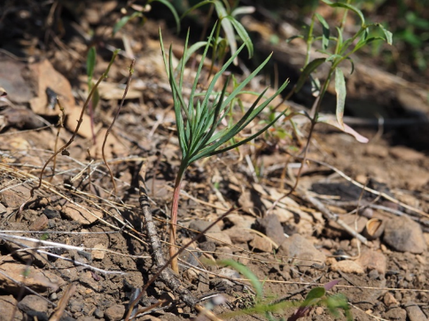
GBV in the Philippines
Local Perspective
Local Laws
Local Resources
Community resistance heals the scorched earth.

Slide 139

Avon Resources & Activities

Slide 140
Role play: Lea
At your tables:
Table Faculty plays role of Lea
2 people play role of interviewers
2 people play role of observers, who will watch the interview and then give the interviewer(s) feedback about what they observed during the interview
Notes:
Instructions: (distribute Practice handouts)

Slide 141
Role play: Debrief
All Roles: How did this experience compare to the initial interview of the day?
Notes:
Instructions: (distribute Practice handouts)

Slide 142
The Multi-Disciplinary Approach
NGOs, prosecutors, law enforcement officers, and the courts all have their roles
As a friend, family member, community member, or Avon Advocate, what do you want your role to be?
Ensuring everyone’s involvement leads to a more supported survivor, who can more meaningfully participate every stage of a case

Slide 143
Moving Forward

Slide 144
Next Steps
UAF
Online Resources
  endgbv.org
    Password: philippines2019!!
Avon Resources

Slide 145




LED BY
SUPPORTED BY
Voices Against Violence: Urgent Assistance Program

Slide 146





Consortium Members

Slide 147
Program Objectives
Increased access to global resources for victims & survivors of GBV
Establishment of an international network to serve as a focal point and coordinate efforts around GBV
Improved protections and access to justice
for victims & survivors of GBV

Slide 148
Urgent Assistance Funds
Funding for survivors who have recently experienced an extreme form of gender-based violence, acute threat or harmful practice and reside in areas with few or no resources for survivors

Slide 149
Eligibility Criteria
An individual of any gender or sexual orientation
Extreme gender-based violence or immediate threat
Most recent violent incident and/or ongoing threats within the last 3 months
No other source of funding is available

Slide 150
How Do You Define Extreme?
Determined on a case-by-case basis
Examples include, but are not limited to:
  Acts that result in
    Serious medical complications
    Permanent disability
    Disfigurement
    And/or long-term loss of livelihood
  Murder threats or attempts
  Torture
  Sex trafficking and/or ongoing sexual abuse or exploitation
  Early and/or forced marriage

Slide 151



What Are Urgent Needs?
Medical expenses
Psychosocial support or counseling
Emergency shelter or other safe accommodation
Temporary relocation expenses
Temporary livelihood support
Legal assistance

Slide 152
How Much Funding is Available Per Survivor?
Amount is determined:
  On a case-by-case basis
  Based on each survivor’s specific urgent needs

Slide 153
Example Case #1
Context:
Mirasol is 22 years old and has an 11 month old son. Mirasol and the child’s father, Crisanto, are not married, but Mirasol moved in with Crisanto when she became pregnant. Crisanto began hitting Mirasol when she moved in, and he often forces her to have sex with him even when she refuses. A few months ago, he beat her and threatened to kill her, putting a knife to her neck.

Slide 154
Example Case #1, cont’d
Extreme GBV & Ongoing Threats:
Two weeks ago, Crisanto tried to strangle Mirasol after giving her a beating that resulted in a fractured forearm, severe abdominal bruising, and possibly a broken rib. Mirasol managed to escape with her son with the help of a neighbor and hid at her cousin’s house. Crisanto called all of Mirasol’s relatives looking for her and threatening to kill her and her son. After Mirasol’s cousin’s husband spoke with Crisanto, he said he was worried Crisanto would soon find out that Mirasol was staying with them and asked her to leave.

Slide 155
Example Case #1, cont’d
Urgent Needs:
Mirasol took her son and came to our shelter yesterday. It is not safe for her to stay here however, because Crisanto has friends who are police officers, and many of the local police officers know the location of our shelter. We want to relocate Mirasol and her son a few hours away, where one of our partner organizations – who provides psychosocial support and vocational training – has agreed to help find a safe place where Mirasol can rent a room.
Mirasol also needs to go to the hospital to get her broken arm set and her
other injuries treated, and she’ll need counseling to help her heal from
the trauma she experienced. She doesn’t have any income, so she wants
to start a small sewing business and will need start-up funds.

Slide 156
Example Case #1
Context:
Mirasol is 22 years old and has an 11 month old son. Mirasol and the child’s father, Crisanto, are not married, but Mirasol moved in with Crisanto when she became pregnant. Crisanto began hitting Mirasol when she moved in, and he often forces her to have sex with him even when she refuses. A few months ago, he beat her and threatened to kill her, putting a knife to her neck.
This information is relevant because it helps us understand that:
Mirasol is a victim of domestic violence, which is a form of gender-based violence
The violence has been escalating
There was a prior
murder/femicide
attempt

Slide 157
Example Case #1, cont’d
Occurred within the last 3 months
Violent Incident:
Two weeks ago, Crisanto tried to strangle Mirasol after giving her a beating that resulted in a fractured forearm, severe abdominal bruising, and possibly a broken rib. Mirasol managed to escape with her son with the help of a neighbor and hid at her cousin’s house. Crisanto called all of Mirasol’s relatives looking for her and threatening to kill her and her son. After Mirasol’s cousin’s husband spoke with Crisanto, he said he was worried Crisanto would soon find out that Mirasol was staying with them and asked her to leave.
Aggravated physical assault and murder attempt shows that the violence is extreme and life-threatening
Death threats indicate that the risk is imminent and ongoing

Slide 158
Example Case #1, cont’d
Urgent Needs:
Mirasol took her son and came to our shelter yesterday. It is not safe for her to stay here; however, because Crisanto has friends who are police officers, and many of the local police officers know the location of our shelter. We want to relocate Mirasol and her son a few hours away, where one of our partner organizations – who provides free psychosocial support and vocational training to survivors of gender-based violence – has agreed to help find a safe place where Mirasol can rent a room.
Mirasol also needs to go to the hospital to get her broken arm set and her other injuries treated, and she’ll need counseling to help her heal from the trauma she experienced. She doesn’t have any income, so she wants to start a small sewing business and will need start-up funds.
Urgent, short-term, often life-threatening needs we can support:
  Relocation
  Safe housing
  Medical care
  Psychosocial support
Medium- to long-term needs we cannot support:
  Business start-up funds
  Vocational/
  job training

Slide 159
Example Case #2
Analyn lives in a gang-controlled neighborhood in Quezon City. Her husband Carlos, who passed away two months ago, ran a small convenience store and payed a monthly extortion fee to the gang to allow him to keep the store open. Analyn took over the business when Carlos passed away, but she hasn’t been able to pay the tax. The gang is now threatening to kill Analyn and her family if she doesn’t pay.

Slide 160
Example Case #3
Rosamie is 17 years old and lives in a gang-controlled neighborhood in Cebu City. A few days ago when Rosamie was walking home from school, she was stopped by a young man who is a known gang member. He made advances toward her and said he wanted her to be his girlfriend. When she declined and started to walk away, he became angry, grabbed her, and sexually assaulted her. He is now threatening to kill Rosamie and her family if she refuses to become his girlfriend.

Slide 161
Reviewing Example Cases #2 and #3
CRITERIA | EXAMPLE CASE #2: ANALYN | EXAMPLE CASE #3: ROSAMIE
Did it occur within the last three months?
Is it extreme?
Is it gender-based violence? | Gang is threatening to kill Analyn and her family because she did not pay the extortion fee. The primary motivation for the violence was economic, not gender-based. | Gang member’s sexual assault of Rosamie and death threats are the result of power inequalities based on gender norms and Rosamie’s refusal to comply with them.

Slide 162
Example Case #4
David, a 27 year-old gay man from Makati City, started dating his boyfriend Gabriel six months ago. Shortly after they began dating, David and Gabriel started receiving threats in the form of anonymous phone calls – an unidentified male caller would express homophobic attitudes, threaten to hurt or kill them if David didn’t leave the neighborhood, and then hang up abruptly. David and Gabriel would block the incoming phone number, but the calls would come from a different phone number each time. They reported the threats to the police, but they said there was nothing they
could do unless they knew who was making the threats.

Slide 163
Example Case #4, cont’d
A week ago, the words “Die homos” were spray painted on the front door of David’s home. Two days after that, David was stabbed multiple times by a stranger outside of his home. He survived the attack and was taken to the hospital, but he needs further treatment, including surgery, that David nor Gabriel cannot afford. They are afraid for their lives and do not feel that David can return home once he is released from the hospital.

Slide 164
Example Case #5
Valerie is a trans woman who lives in Quezon City. A week and half ago, she was cornered and attacked by a group of men, who took turns raping her and beating her. They left her unconscious in a parking lot.

Slide 165
Reviewing Example Cases #4 and #5
CRITERIA | EXAMPLE CASE #4: DAVID | EXAMPLE CASE #5: VALERIE
Did it occur within the last three months?
Is it extreme?
Is it gender-based violence? | Threats and act of violence that resulted from power inequalities based on gender roles and norms | Act of violence that resulted from power inequalities based on gender roles and norms

Slide 166
What If I’m Not Sure If a Case Meets This Criteria?
We make funding decisions on a case-by-case basis, taking into account each survivor’s unique context and needs.
If you are not sure if a case meets the initiative’s criteria, please ask us!
If we are not able to support a case, we will do our best to help identify other resources to support the survivor.

Slide 167
How Does the Process Work?
Send an email to GBVresponse@gmail.com
Include basic details only, including:
  Type/Nature of violence or threats
  Date violence occurred (or date of most recent, direct threat)
  Who was the perpetrator (e.g. stranger, relative,
  intimate partner, etc.)

Slide 168


How Does the Process Work? cont’d
Security Considerations
        Please use Gmail for all case-related communications
          GBVresponse@gmail.com is monitored 24/7
          Gmail is more secure than Vital Voices email accounts or Skype
        Virtru is a free service that encrypts emails for added security

Slide 169
How Does the Process Work? cont’d
If we believe a case meets our criteria, we will send you a link to a password protected and encrypted referral form

Slide 170
Frequently Asked Questions
Can you provide funds for survivors of an extreme form of GBV to help them get back on their feet?
Funds are limited to support urgent needs directly resulting from extreme violence
Funds are not available to support medium to long-term needs, such as ongoing medical expenses for chronic issues, educational or vocational training, business startup costs, etc.

Slide 171
Frequently Asked Questions, cont’d
I work for an NGO offering services to survivors of GBV. Can funds be used to support the services organizations like mine offer to survivors?
Support from this program is provided to survivors of extreme forms of gender-based violence either through an intermediary, like an NGO, or directly to the survivor. Assistance is granted only on an individual basis for particular needs that cannot be met by the referring organization.
We are not able to fund general services provided on the part of organizations that work with survivors.

Slide 172
Questions?

Slide 173
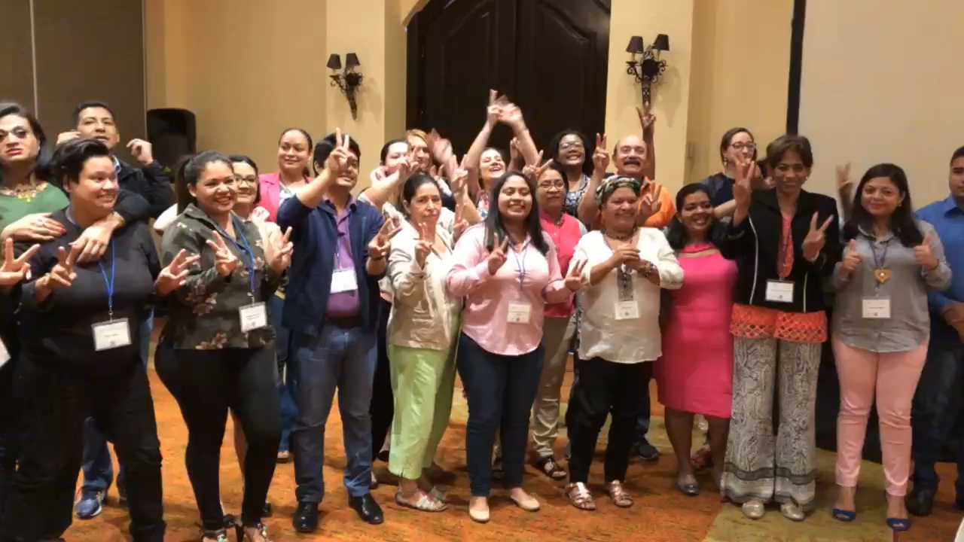
“One Word” & Conclude for the Day
Thank you!

